Slide 1
Linear Discriminant Analysis(LDA)
AUM SRI SAIRAM

Slide 2
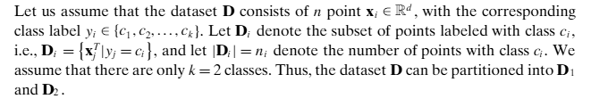
What is LDA?
The goal of linear discriminant analysis (LDA) is to find a vector w that maximizes the separation between the classes after projection onto w.

Slide 3
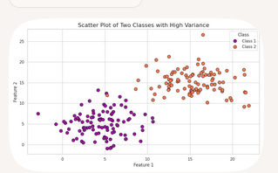
Two classes with large Variance:Challenge

Slide 4
Data Set
x1 | x2 | y
0.450879 | 0.132868 | c1
1.879524 | 1.240878 | c1
2.769673 | 1.271422 | c1
2.381673 | -0.085283 | c1
0.876277 | 1.023040 | c1
2.647753 | 1.108029 | c1
1.563462 | 0.665282 | c1
2.552341 | 0.184051 | c1
1.431752 | 0.886741 | c1
2.063362 | -0.038390 | c1
0.355146 | 0.530248 | c1
1.937572 | 2.387883 | c1
2.359125 | 0.118055 | c1
2.892172 | -0.276944 | c1
1.065994 | 0.383006 | c1
5.975707 | 4.621600 | c2
6.730952 | 3.933731 | c2
6.848493 | 2.874139 | c2
6.516574 | 4.790887 | c2
3.206102 | 4.261482 | c2
4.140567 | 4.106317 | c2
4.269608 | 3.577428 | c2
6.232002 | 2.085232 | c2
5.160823 | 5.873123 | c2
4.613864 | 3.668347 | c2
3.198801 | 4.748265 | c2
4.961358 | 4.227667 | c2
5.055209 | 3.718665 | c2
6.512988 | 3.970820 | c2
5.375011 | 4.906609 | c2

Slide 5
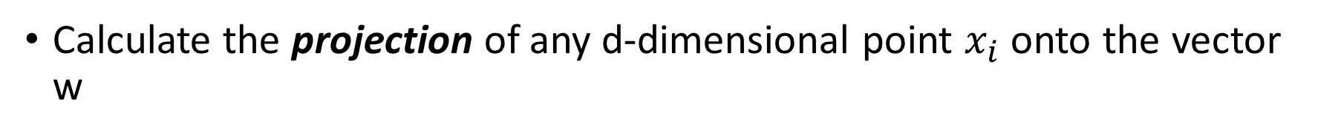
Projection on w

Slide 6
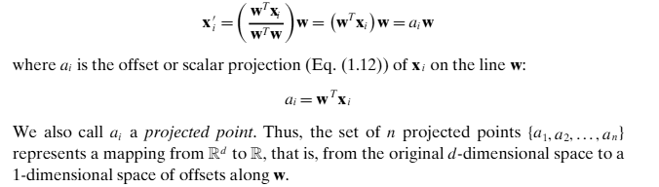

Slide 7
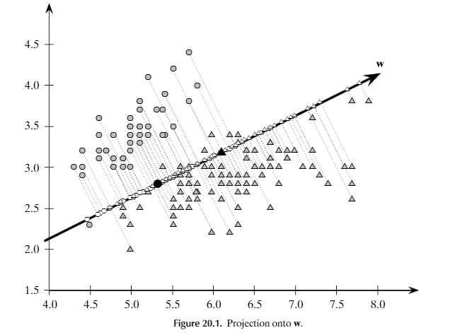
Projection onto w

Slide 8
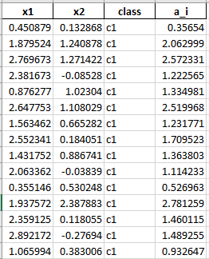

Slide 9
Mean of projected Points
Calculate the mean of the projected Points

Slide 10
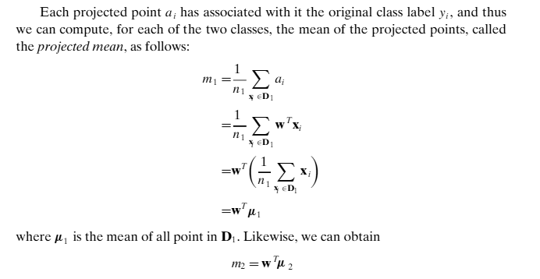
The mean of the projected points is the same as the scalar projection of the mean

Slide 11
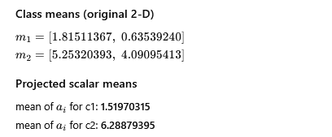

Slide 12
LDA Criteria?
Maximize the distance between two classes.
Reduce the variance in each class
Why? and How?

Slide 13
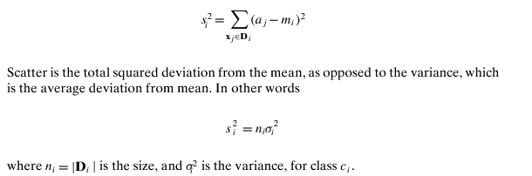
To maximize the separation between the classes, it seems reasonable to maximize the difference between the projected means, |m1−m2|.
LDA maximizes the separation by ensuring that the scatter
for the projected points within each class is small, where scatter is defined as

Slide 14
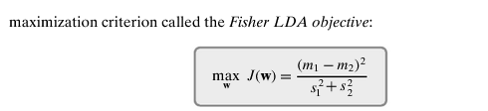
Combining the 2 criterias using a SINGLE criterion
w: Optimal LInear Discriminant(LD)
Numerator: Separation between classes/ Scatter between classes
Denominator: Variance inside the classes/Scatter within class

Slide 15

Within Class Scatter Matrix

Slide 16

Geometric interpretation
B is the outer product of a single vector d=μ1−μ2 ​.
The range of B is spanned by d only.
Therefore, the matrix has only one nonzero eigenvalue, and hence its rank is 1.
So The between-class separation has only one direction — That is the line connecting μ1​ and μ2​.

Slide 17
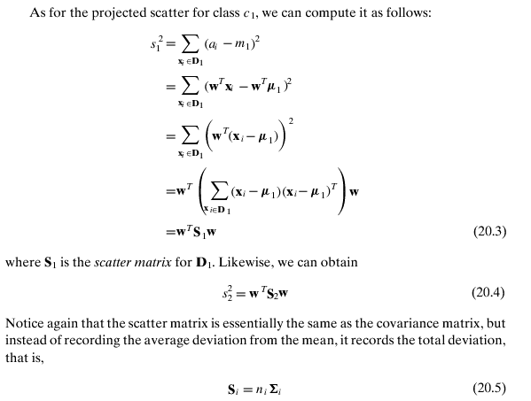

Slide 18

Based on Attribute View….
Where S = S1+S2 denotes the within-class scatter matrix for the given data.
Because both S1 and S2 are d × d symmetric positive semidefinite matrices, S has the same properties.

Slide 19

So the Criterion Looks like
Maxima Problem in differentiation….

Slide 20
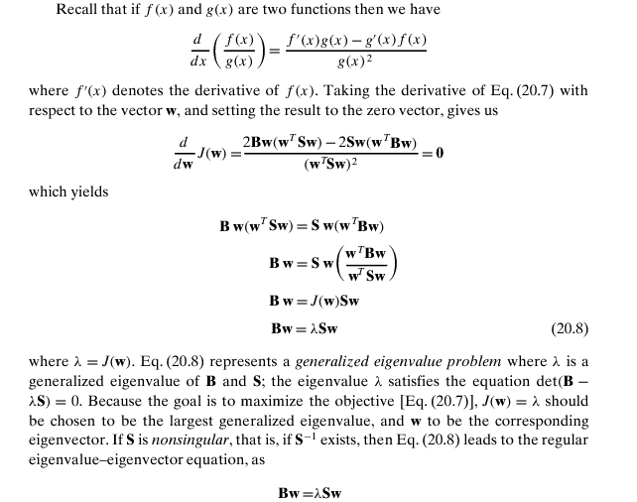

Slide 21
Singular and Non-Singular
Determinant
Linear Independence
Invertible

Slide 22
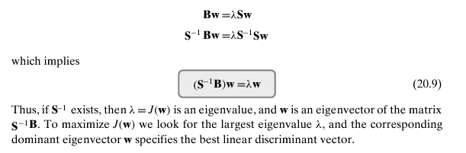
The Conclusion

Slide 23
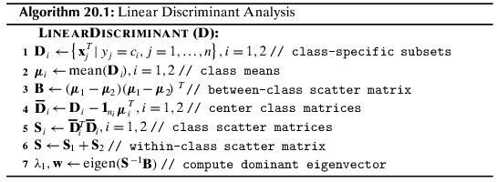
The Algorithm

Slide 24
PCA vs LDA
Principal Component Analysis (PCA):
• Works with unlabeled data.(T/F)
• Maximizes total variance of projected data.(T/F)
• Finds directions of greatest variance regardless of class labels.(T/F)
Linear Discriminant Analysis (LDA):
• Works with labeled data.
• Maximizes separation between classes relative to within-class scatter.
• Finds discriminative directions for classification.

Slide 25
Jai Sairam

